Slide 1
Taxonomic classifiers, principles and methods
EU COST Blastocystis Action: Training School in Microbiome Data Analysis
Barcelona April 2024

Slide 2
Taxonomic classifiers
QIIME2
DADA2
VEGAN
Kraken2
Decipher
RDP
BLAST
UCLUST
SortMeRNA
BION
…

Slide 3
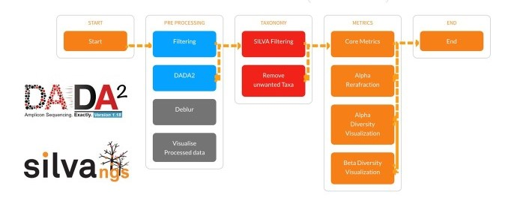
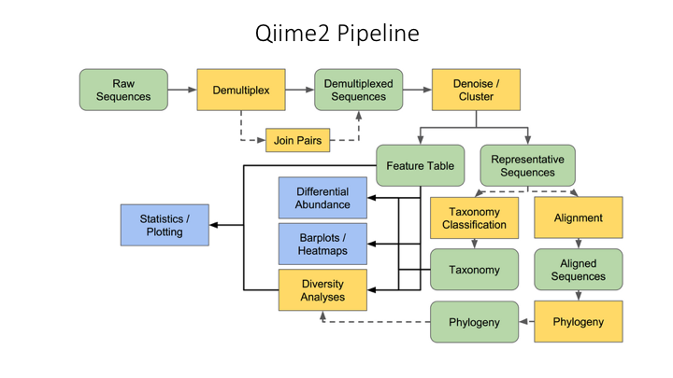
Taxonomic classifier pipelines
Sequence extraction
Sequence cleaning
Pair mate joining
Length and quality filtering
Sequence uniqification
Chimera filtering
Sample sequence clustering
Making reference similarities
Similarity profiling
Taxonomy profile tables
BION
Collecting raw data
Raw data QC
Mapping optimization
Mapping
Data Presentation
Demultiplexing
Joining
Trimming
Filtering
Clustering
Chimera
Assembly
Alignment
K-mer
Table
Cladogram
Chart

Slide 4
What are the challenges?

Slide 5
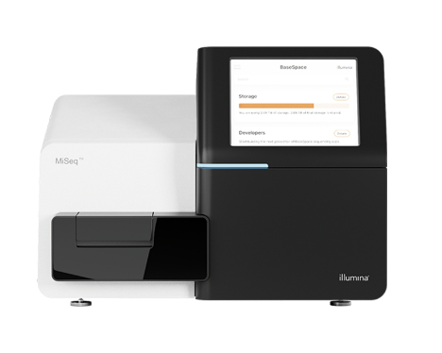
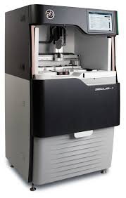
Available resources
Sequences
Illumina
PacBio
IonTorrent
ONT
Server power
Technical support
Reference database

Slide 6
Reference databases
Greengenes
RDP
SILVA
UNITE
ROD
Eukaryote
Prokaryote
Host
Or… make your own…
Depending on the environment (i.e. host, sample type), some databases are better than others

Slide 7
Taxonomy
Prokaryotes
Eight tier frame
Species/groups are subject to change
Eukaryotes
Infinite tier frame
Species/groups are subject to change
NCBI taxonomy browser
SILVA taxonomy browser
RDP taxonomy browser
EOL.org

Slide 8
Mapping criteria When do we accept a mapped species to be true?
Interspecific sequence diversity
Distance between E. coli and Shigella
Intraspecific sequence diversity
Distance between two E. coli subtypes
Interspecific vs. Intraspecific
Genomic region differences
SSU vs. ITS

Slide 9
Take home message
For

Slide 10
Use the Classifier that suits your data and resources
Use the reference DB that works the best
Be critical of references
Be aware of differences in results between studies due to methodology, technique, region, DB, …
Always confirm significant species
Collaborate with others
Structure your metadata from the start

Slide 11
Questions?

